Slide 1
Working with OPEN SOURCE GEOSPATIAL DATA
Jim Spring
MNE 520
University of Arizona

Slide 2
Project Description (Original)
This project focuses on working with data from the Mineral Resource Data System as well as historical and current mining claim data from the Bureau of Land Management.
The geospatial functionality within MS SQL Server will be used to handle the necessary geo-queries.
Data will be overlayed and shown on a map within a browser using Open Street Maps.
The system will use Python as the layer to communicate with MS SQL Server and relay the location and bounded region within the browser.
Finally, the code is written and running as a web application.

Slide 3
Project Description (REAL)
This project focuses on working with data from the Mineral Resource Data System.
Data is stored within a stripped down version of MS SQL Server.
Geospatial queries use a bounding box using MS SQL SELECT BETWEEN.
Data will be overlayed and shown on a map within a browser using Open Street Maps.
The system will use Python as the layer to communicate with MS SQL Server and relay the location and bounded region within the browser.
Finally, the code is written and running as a web application.

Slide 4
Why the difference?
Hardware failure. My MacBook Pro keyboard went on the fritz and is at Apple for repair.
My backup system is a MacBook Air using Apple’s new chip.
MS SQL Server does not run on this new platform, however there is a stripped down offering that does. It does not support the geospatial capabilities.
The above lead to more time to get things working rather than expanding the application.

Slide 5
OuR DATASET
The condensed MRDS data set is a single file in CSV format with 55 fields, including Latitude and Longitude.
An example:
dep_id,url,mrds_id,mas_id,site_name,latitude,longitude,region,country,state,county,com_type,commod1,commod2,commod3,oper_type,dep_type,prod_size,dev_stat,ore,gangue,other_matl,orebody_fm,work_type,model,alteration,conc_proc,names,ore_ctrl,reporter,hrock_unit,hrock_type,arock_unit,arock_type,structure,tectonic,ref,yfp_ba,yr_fst_prd,ylp_ba,yr_lst_prd,dy_ba,disc_yr,prod_yrs,discr
10000001,"https://mrdata.usgs.gov/mrds/show-mrds.php?dep_id=10000001",A010000,,"Lookout Prospect",55.05612,-132.14344,NA,"United States",Alaska,,M,Copper,"Gold, Silver",,Unknown,,N,Occurrence,"Chalcopyrite, Covellite, Pyrite","Quartz, Sericite",,,,,,,"Conundrum, Mammoth, Wakefield Minerals Co.",,"Hirschmann, M. M. (Elliott, R. L.)",,Schist,,,"Schist Strikes N65w, Dips 70sw",,"USGS PROFESSIONAL PAPER 1, P. 75-77.USGSBULL 347, P. 131.USGS BULL 1246, P. 174USGS MF 433USGS OF 78-869, P. 117",,,,,,,,
It’s a lot to take in, the first line is the headers, the second the first row of data. Lat/Lon are highlighted.

Slide 6
Lat/Lon - Decimal to GEOSPATIAL
The following query, in MSSQL, adds a GEOGRAPHY field to the table and converts the Lat/Lon fields to a point:
USE mrds;
ALTER TABLE mrds
ADD geolocation GEOGRAPHY;
UPDATE mrds
SET geolocation = geography::STPointFromText('POINT(' + CAST(longitude AS VARCHAR(20)) + ‘ ‘ + CAST(latitude AS VARCHAR(20)) + ')', 4326);

Slide 7
Working With OPEN Street Map (OSM)
OSM is an open source mapping database that can be used for visualizing apps, etc. It does not, by default, require an API key like Google.
This application interacts with OSM using the JavaScript API OpenLayers (https://openlayers.org)
OpenLayers handles the interaction with OSM and OSM tiles as well as managing the placing of features onto the map.

Slide 8
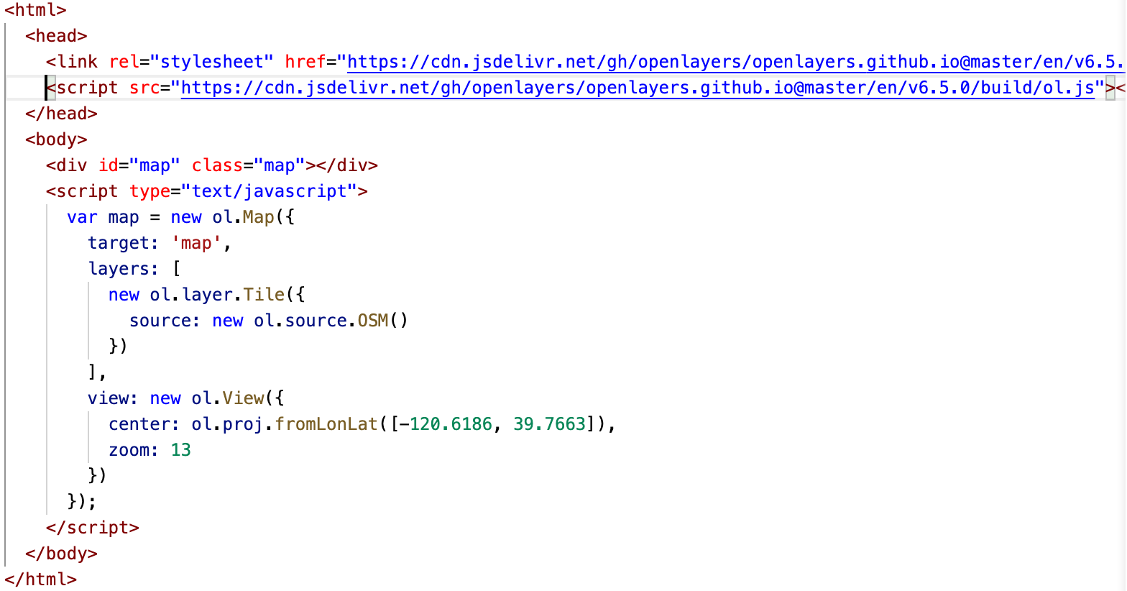
What About CODE?
The minimal code in an html file to use OpenLayers and display a map for a given location is:

Slide 9
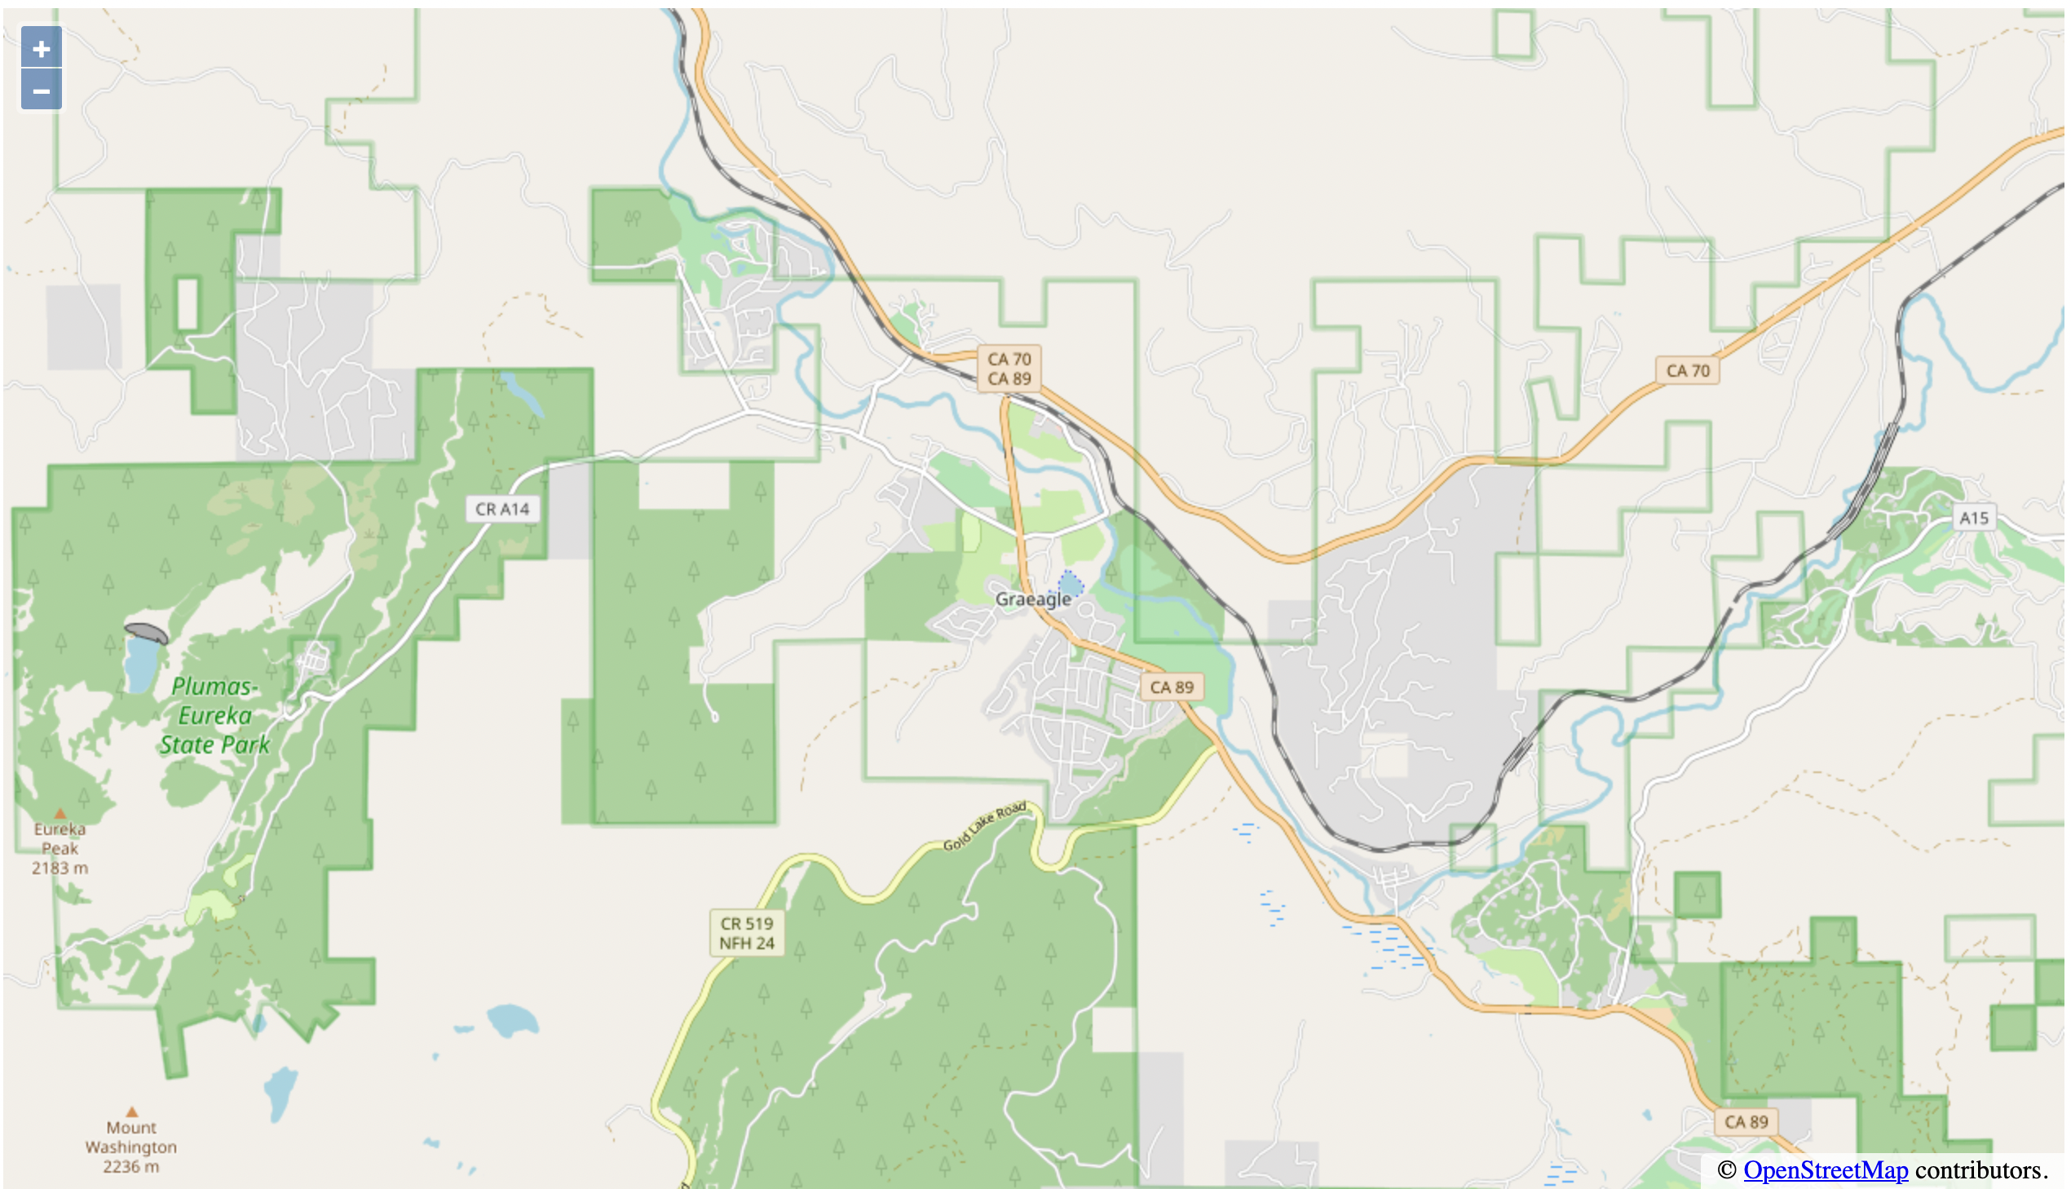
What does it look like?

Slide 10
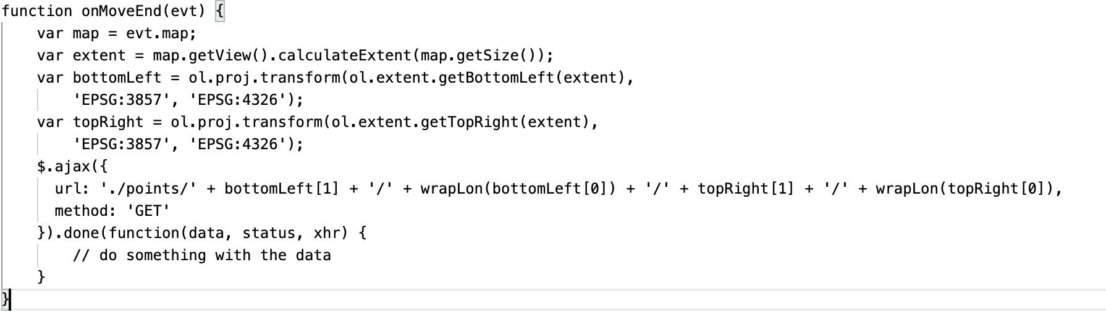
How do we get nearby MRDS Items?

Slide 11
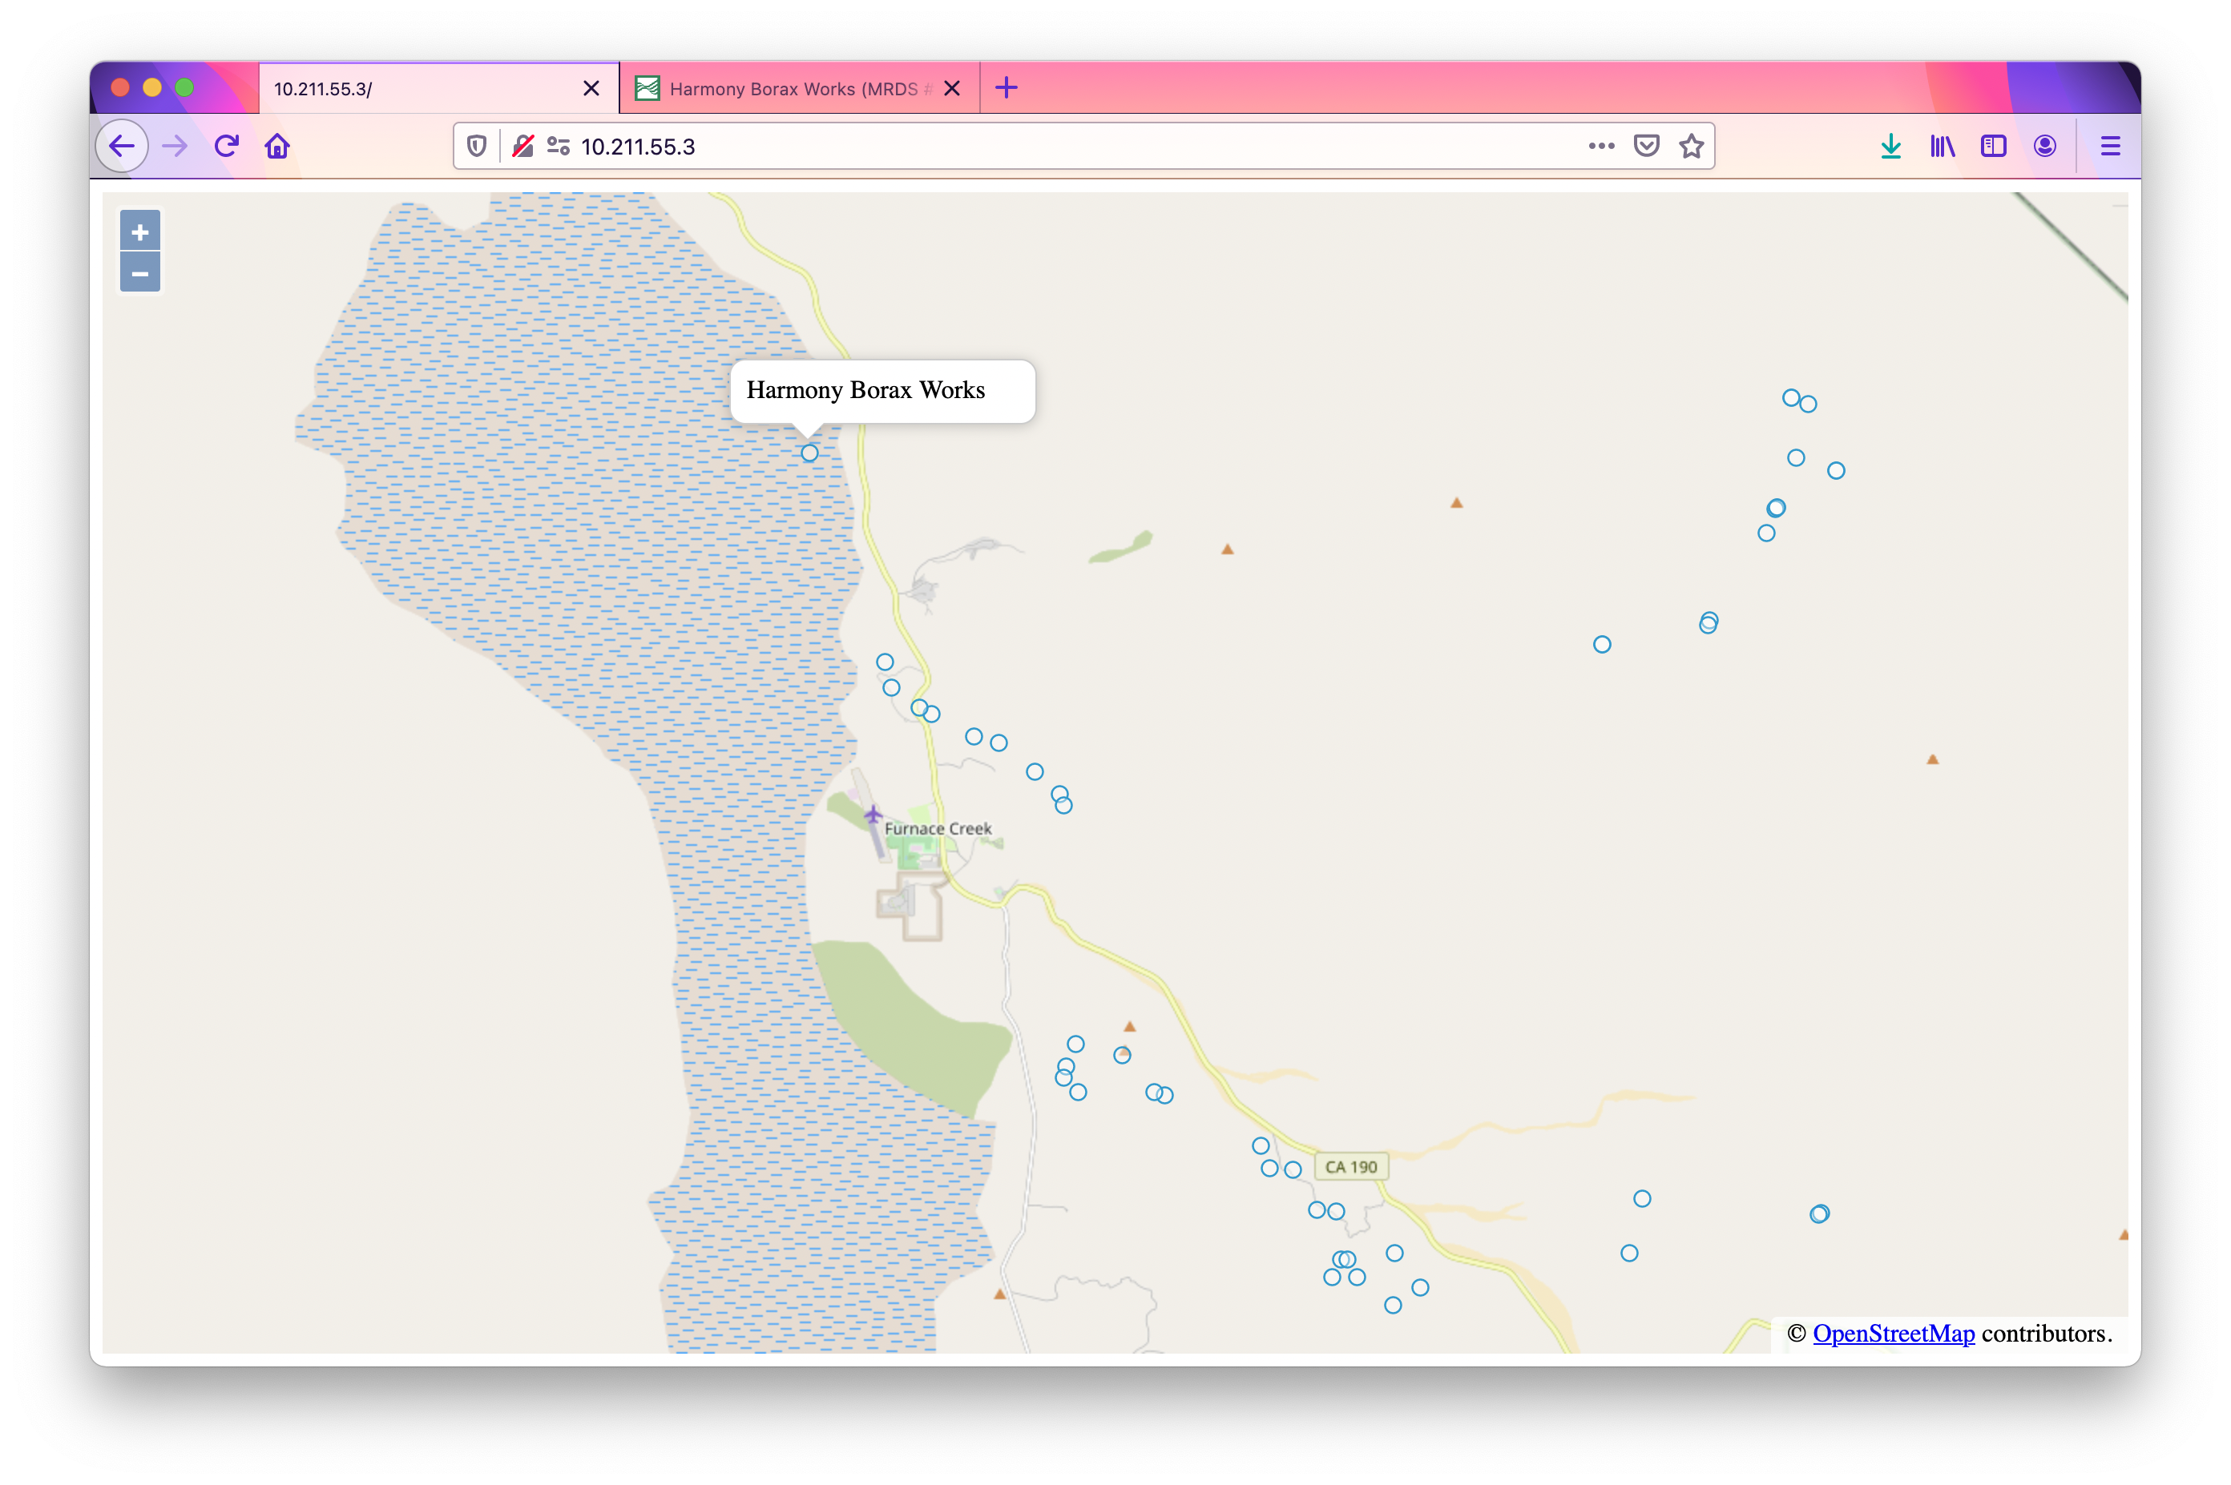
What do FEATURES LOOK LIKE?

Slide 12
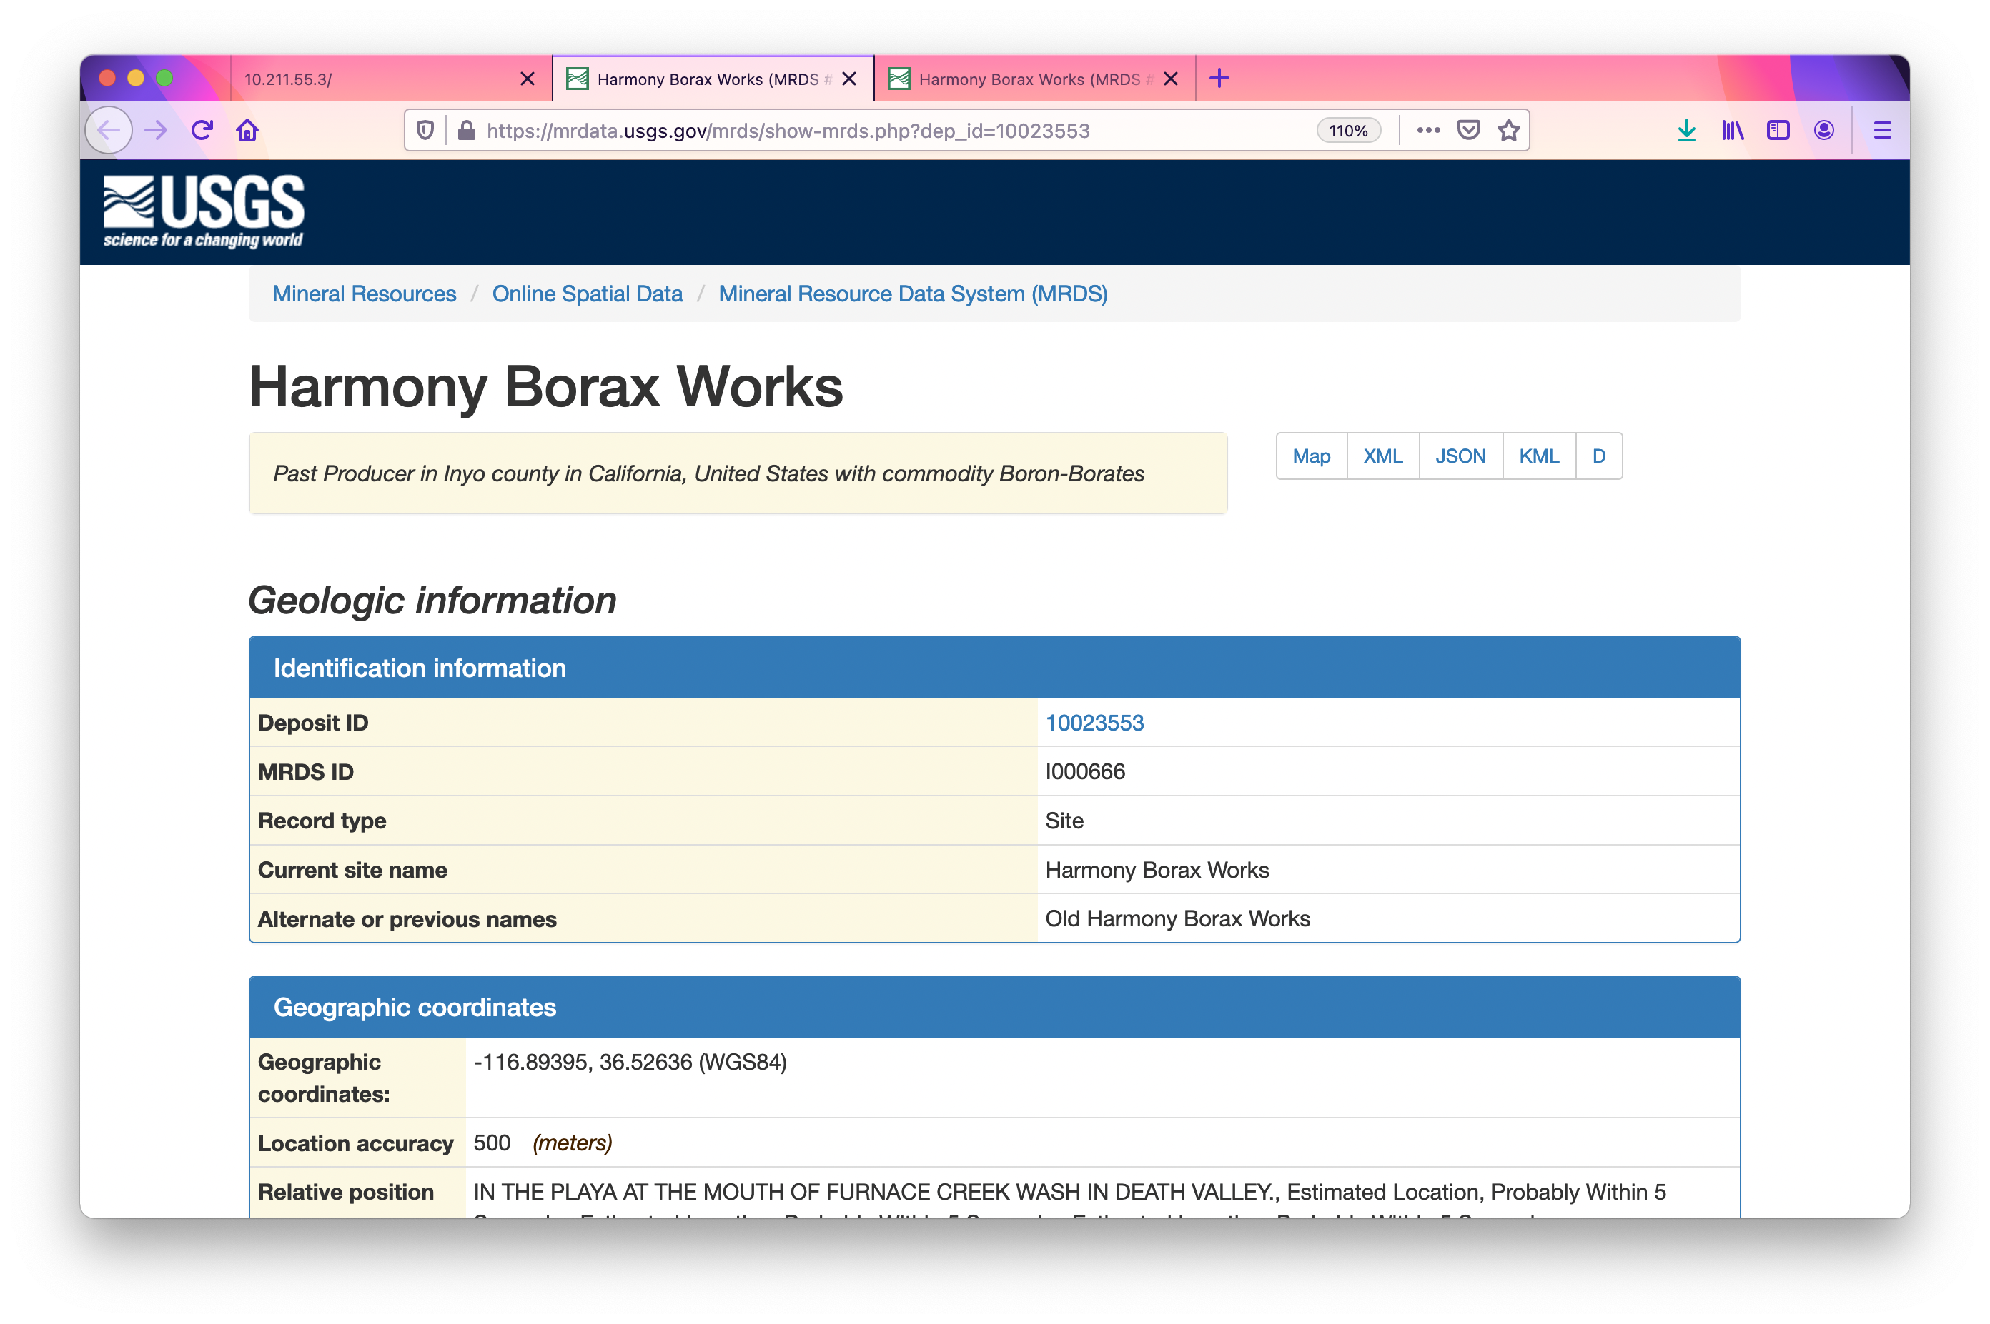
WHAT HAPPENS WHEN YOU CLICK ON A FEATURE

Slide 13
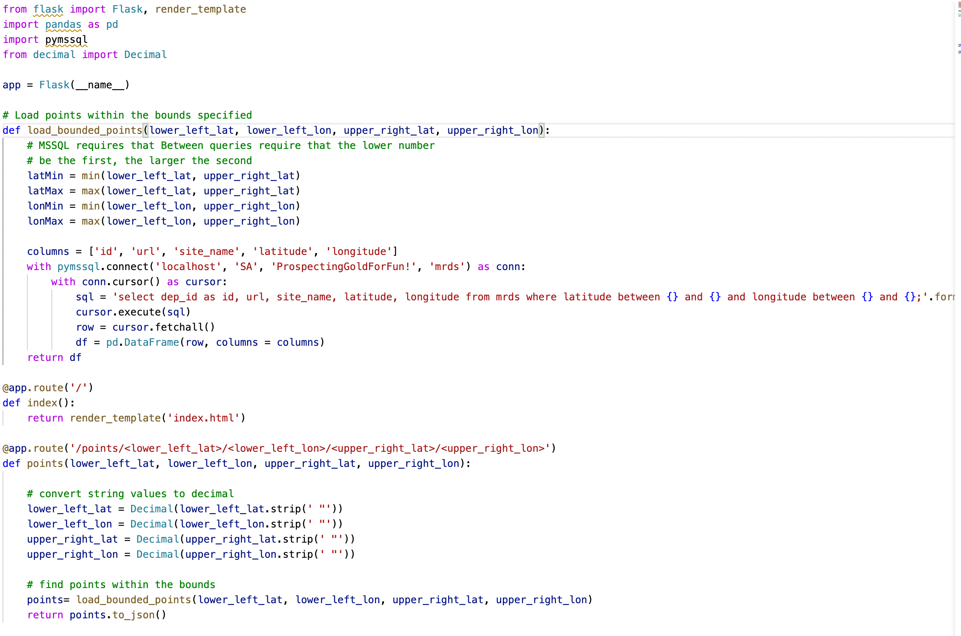
What ABOUT THE WEB SERVICE?

Slide 14
Related videos
Database setup - https://github.com/jmspring/uofa_mne520_project/blob/main/videos/database_setup.mp4
Application overview - https://github.com/jmspring/uofa_mne520_project/blob/main/videos/app_overview.mp4

Slide 15
References
Mineral Resource Data System - https://mrdata.usgs.gov/mrds/
Open Street Map - https://www.openstreetmap.org
Open Layers - https://openlayers.org/

